Slide 1
CRUNCHY BITS
presents

Slide 2
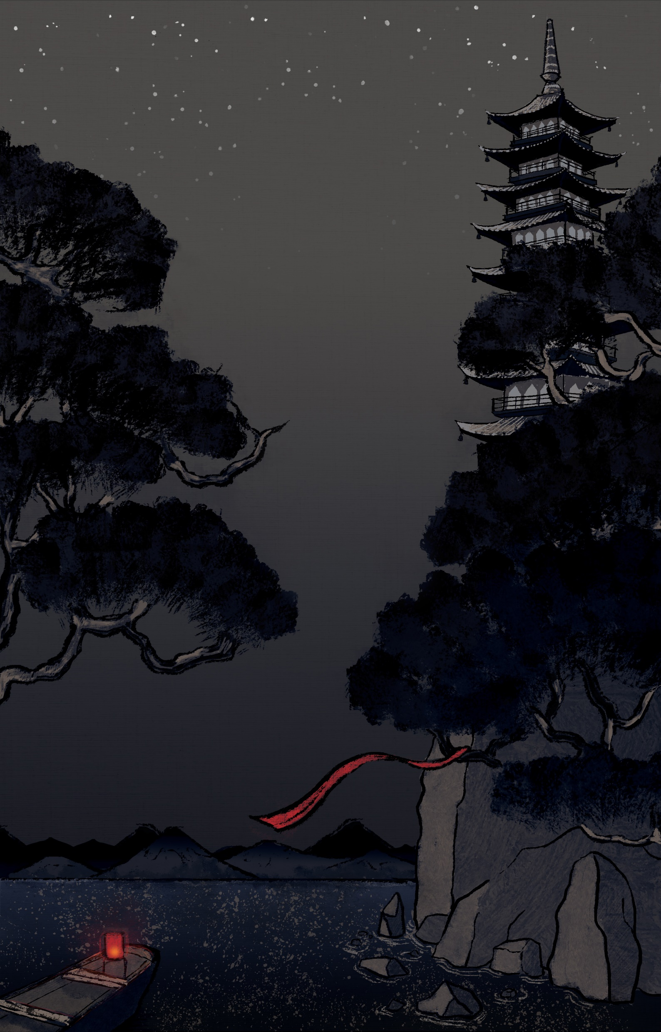


Slide 3
Project Goals
1: Concentrate on one simple mechanic but make it pop!
2: Polish it until it shines.

Slide 4
Scope
Must Have | Should Have | Nice to Have
Swiping Combat Mechanic ✔ | Particle Effects ✔ | Bosses CUT
Enemies x3 ✔ | Adaptive UI ✔ | Enemies x6 ✔
Player Character ✔ | Overworld ✔ | Level x3 ✔
Animations ✔ | Score ✔ | Achievements CUT
Level x1 ✔ | Stylized 3D Environments ✔ | Unlockables (Skins) CUT
SFX ✔ | Traditional Instrumentation ✔
 | Unique Monster Sounds ✔

Slide 5
Dev Log
The nitty gritty

